Slide 1
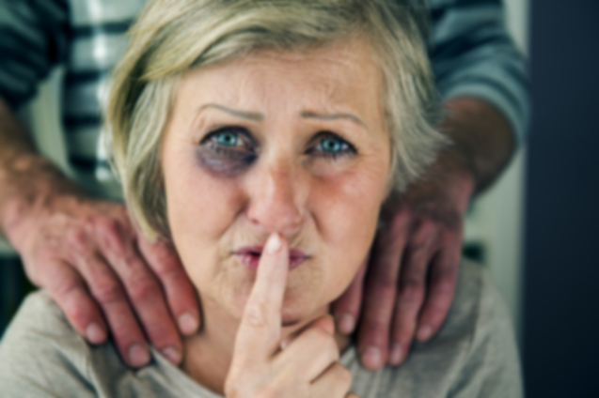
Elder Mistreatment

Slide 2
Learning Objectives
Define elder mistreatment and types
Describe prevalence and risk factors
Review consequences
Mandatory reporting

Slide 3
Elder Mistreatment
Elder mistreatment is any knowing, intentional, or negligent act by a caregiver or any other person of “trust” that causes harm or a serious risk of harm to a vulnerable adult
Elder Mistreatment
11%
Psychological Abuse
3.2%
Physical Abuse
1.6%
Sexual Abuse
0.6%
Financial Exploitation
5.2%
Caregiver Neglect
5.1%
Self-Neglect
5.1%

Slide 4

Mistreatment
Financial
Exploitation
Abuse
Neglect
Physical
Emotional
Sexual
Caregiver
Self
Physical
Medical
Mental
Health

Slide 5
Physical Abuse
Definition
Examples
Signs
Intentional use of physical force against another, with or without an object, regardless of resultant harm
Pushing, shoving, kicking, hitting, slapping, hair pulling, restraining, force-feeding, burning, cutting, stabbing, shooting, scratching, biting
Implausible / inconsistent stories, injuries that are: defense, flexor, internal, head/face, non-extremity, object-shaped

Slide 6
Sexual Abuse
Definition
Examples
Signs
Intentional sexual contact against non-consenting or consent-incapable another, regardless of resultant harm
Rape, sexual assault, human trafficking, nudity, indecent exposure, photography, videography, touching, sexual advances, lewdness, flashing, quid pro quo
STIs, retained biologic material, behavior or mood changes, injuries to: oral cavity, genitals, buttocks/anus, breasts

Slide 7
Emotional, Psychological, or Verbal Abuse
Definition
Examples
Signs
Intentional verbal / non-verbal action against another, regardless of resultant harm
Berating, harassing, intimidating, threatening action or inaction, infantilizing, isolating, manipulating, cursing
Changes in: behavior, mood, self-care, socialization, self-esteem, outlook

Slide 8
Caregiver Neglect and Abandonment
Definition
Examples
Signs
Not fulfilling care obligations of another resulting in risk of or actual harm, regardless of intent
Preventing appropriate access to food, water, clothing, shelter, healthcare, hygiene, physical aids, safety; leaving unattended
Stockholm Syndrome/clinginess to caregiver, healthcare distrust, treatment plan interference, financial dependence, troublesome caregiver personal history, isolating, severe punishments, infantilizing, manipulations

Slide 9
Financial or Economic Abuse / Exploitation
Definition
Examples
Signs
Intentional improper or illegal use of another’s funds, assets, property, resources, belongings, regardless of resultant harm
Stealing, forgery, “skimming”, contractual coercion / alteration, unwanted POA, scams, fraud, threats of fiscal ruin, age-/disability-targeted financial manipulation, new lines of credit / loans
New/changed: self-care, legal documents, “friends” or “partners”, spending habits, credit score, POA, property ownership, missing items

Slide 10
Prevalence and Risk Factors

Slide 11

Key Facts: Elder Mistreatment in the US
Elder mistreatment is associated with a 300% increase in risk of death⁴
10%
of older adults in the US are affected by elder mistreatment¹
$5.3B
is the annual cost of elder mistreatment-related health care expenditures³
Types of mistreatment include
» Caregiver neglect
» Financial exploitation
» Emotional/Psychological abuse
» Physical abuse
» Sexual abuse
» Self-neglect
1 in 14
cases are reported to authorities²
Reporting suspected mistreatment is mandated in each of the United States except NY⁵

Slide 12
Other Prevalence-Related Facts
The number of adults ≥60 years expected to double by 2050 (NCEA)
Common, yet under-reported & under-recognized
  2/3 nursing home workers admit to mistreatment
  1 in 24 cases reported to authorities (WHO 2018)
    Financial exploitation self-reported the most
Known perpetrators are ~60% family members
Neglect, emotional abuse, exploitation > physical & sexual abuse

Slide 13
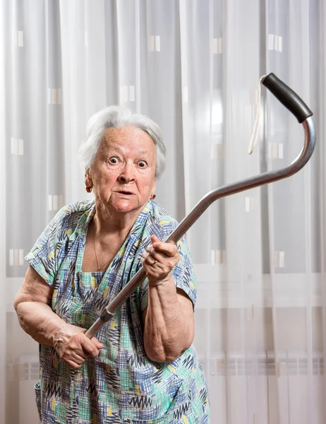


Risk Factors
Cognitive impairment
Decisional incapacity
Neuropsychiatric behaviors
  (e.g., agitation, aggression)
Functionally dependent
Family violence
Traumatic events
Substance use
Social isolation
Loneliness

Slide 14
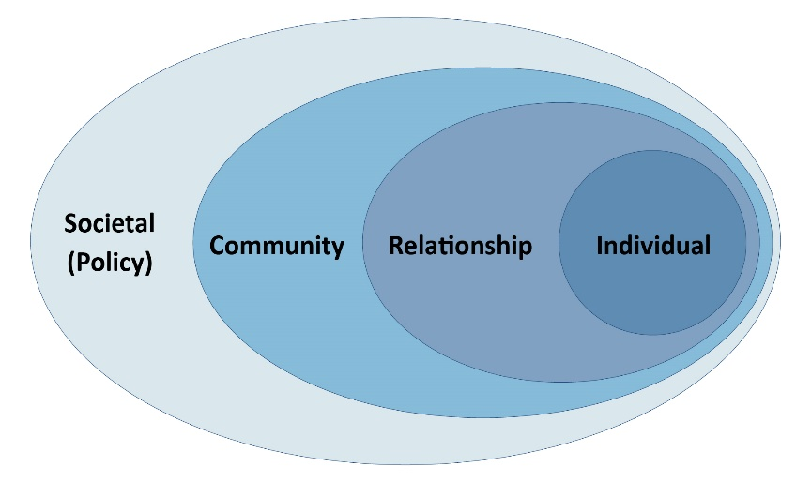
Social Determinants of Elder Mistreatment
Individual
Age
Female
Physical, Cognitive, Mental, Impairments requiring support (i.e. Dependency)
Prior Traumatic Event
Loneliness
Isolation
Interpersonal
Contentious relationships with others
Cohabitation (Adult Child)
Close proximity of someone with an addiction
Lack of Social Support
Poor perceived support
Community and Societal
Low awareness
Low Surveillance
Low Reporting
Lacking Policy
Ageism

Slide 15
Consequences

Slide 16
Consequences of Elder Mistreatment
PHYSICAL, PSYCHOLOGICAL & SOCIAL HEALTH
Early mortality
Functional decline & dependency
Exacerbated chronic conditions
Lower self-rated health
Psychological decline
Helplessness
Fear
Social isolation
Stress
FINANCIAL
Personal financial loss
Increased emergency room visits and hospitalizations
Longer hospital stays
Higher rates of skilled nursing facility admissions
Notes:
Script: Elder mistreatment has devastating consequences for older adults, families, and communities.
Here we group the effects of elder mistreatment into health-related and financial-related consequences.
[CLICK] Health related consequences include early death, as we mentioned earlier as well as decline in functional ability, increased dependency on caregivers, exacerbated health conditions, reductions in self-rated health, psychological decline and feelings of helplessness, fear, and stress as well as social isolation.
[CLICK] Financial consequences include direct loss to victims of financial exploitation, as well as costs related to health care such as increased emergency department visits and hospitalizations, longer hospital stays, and higher rates of admission to skilled nursing facilities.
CITES:
Functional Decline- Lachs, M.S., Williams, C.S., Obrien, S., Hurst, L., Kossack, A., Siegal, A., & Tinetti, M.E. (1997). ED use by older victims of family violence. Annals of Emergency Medicine, 30(4), 448–454 doi: http://dx.doi.org/10.1016/S0196-0644(97)70003-9; Baker, M.W., LaCroix, A.Z., Wu, C.Y., Cochrane, B.B., Wallace, R., & Woods, N.F. (2009). Mortality risk associated with physical and verbal abuse in women aged 50 to 79. Journal of the American Geriatrics Society, 57(10), 1799–1809. doi: 10.1111/j.1532-5415.2009.02429.x
Exacerbated chronic conditions, social isolation - Anetzberger, G. (2004). The Clinical Management of Elder Abuse. New York, NY: Hawthorne Press.
3. Lower self-rated health, hopelessness, psychological decline, stress, fear- Wong JS & Waite LJ (2017). Elder mistreatment predicts later physical and psychological health: results from a national longitudinal study. J Elder Abuse Negl. Jan-Feb, 29(1): 15-42.
Increased ER and hosptial visits - Dong, X. Q., & Simon, M. A. (2013). Elder abuse as a risk factor for hospitalization in older persons. JAMA Internal Medicine, 173 (10), 911–917. doi: 10.1001/jamainternmed.2013.238
Mortality - Dong, X, Simon, M., Mendes de Leon, C., Fulmer, T., Beck, T., Hebert, L. (2009). Elder self-neglect and abuse and mortality risk in a community-dwelling population. Journal of the American Medical Association, 302(5), 517–526. doi: 10.1001/jama.2009.1109
SNK and longer hospital stays: dong X. Medical implications of elder abuse and neglect. Clinics in geriatric medicine. 2005;21(2):293-313.
Personal financial loss: https://www.asaging.org/blog/update-nature-and-scope-elder-abuse

Slide 17
Differential Mortality

Slide 18
Reporting

Slide 19
Mistreatment
YOU!
Financial
Exploitation
Abuse
Neglect
Physical
Emotional
Sexual
Caregiver
Self
Physical
Medical
Mental
Health

Slide 20
Mandatory Reporting
“Knowingly failing to report is a Class A misdemeanor ... is punishable by fine not to exceed $ 4,000; … jail for a term not to exceed one year; or both.”
“You may be subject to civil and/or criminal liability if you knowingly file a false report (for example, telling DFPS the child has injuries when there clearly are none).”
“You are protected from civil or criminal liability for making a false report, as long you made the report honestly, sincerely and without malicious intent … even if DFPS determines that there was no abuse or neglect.”

Slide 21
This Is Where You Come In!
We need you to be vigilant of the signs of mistreatment.
Physical Abuse:
Implausible / inconsistent stories, injuries that are: defense, flexor, internal, head/face, non-extremity, object-shaped
Sexual Abuse:
Implausible / inconsistent stories, injuries that are: defense, flexor, internal, head/face, non-extremity, object-shaped
Financial or Economic Abuse/Exploitation:
New/changed: self-care, legal documents, “friends” or “partners”, spending habits, credit score, POA, property ownership, missing items
Emotional, Psychological, or Verbal Abuse:
Changes in: behavior, mood, self-care, socialization, self-esteem, outlook
Caregiver Neglect and Abandonment:
Changes in: behavior, mood, self-care, socialization, self-esteem, outlook
When your suspicion is raised, you should...

Slide 22
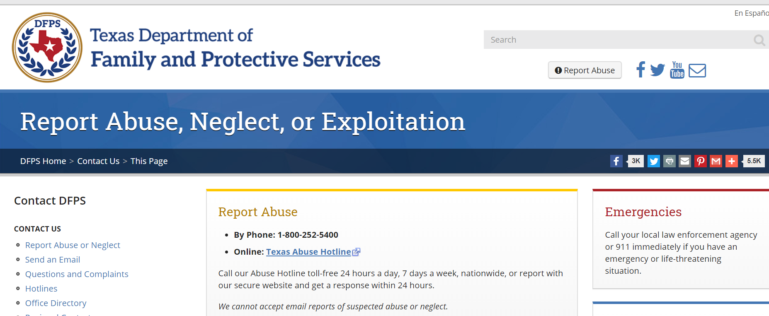
https://www.txabusehotline.org/Login/Default.aspx
Click me!

Slide 23

Tips for Reporting
You are a mandatory reporter by law
You don’t have to be certain, just suspicious
You don’t need to have the answer for mistreatment or a management plan
Important that it gets reported if suspected even if you hand this off to other staff

