Slide 1
Collecting Your Information
REDCap Introduction

Slide 2
Objectives
REDCap
Where you will be documenting the assessment data
Where you will be journaling

Slide 3
What will REDCap be used for?
REDCap is a secure web platform for building and collecting online databases and surveys.
It will be used to capture student and older participant data.
You will log your call information using the REDCap link, where the data will be securely stored.
Assessments
Journaling

Slide 4
Student Engagement Timeline
Week 1 | Week 2 | Week 3 | Week 4 | Week 5 | Week 6 | Week 7 | Week 8
Call #1 | Call #2 | Call #3 | Call #4 | Call #5 | Call #6 | Call #7 | Call #8
Patient Health Questionnaire – 2 | Patient Health Questionnaire – 2 | Patient Health Questionnaire – 2 | Patient Health Questionnaire – 2 | Patient Health Questionnaire – 2 | Patient Health Questionnaire – 2 | Patient Health Questionnaire – 2 | Patient Health Questionnaire – 2
Generalized Anxiety Disorder Scale-2 | Generalized Anxiety Disorder Scale-2 | Generalized Anxiety Disorder Scale-2 | Generalized Anxiety Disorder Scale-2 | Generalized Anxiety Disorder Scale-2 | Generalized Anxiety Disorder Scale-2 | Generalized Anxiety Disorder Scale-2 | Generalized Anxiety Disorder Scale-2
Call Summary/ Journaling | Call Summary/ Journaling | Call Summary/ Journaling | Call Summary/ Journaling | Call Summary/ Journaling | Call Summary/ Journaling | Call Summary/ Journaling | Call Summary/ Journaling
Mental Health Referral if Necessary | Mental Health Referral if Necessary | Mental Health Referral if Necessary | Mental Health Referral if Necessary | Mental Health Referral if Necessary | Mental Health Referral if Necessary | Mental Health Referral if Necessary | Mental Health Referral if Necessary

Slide 5
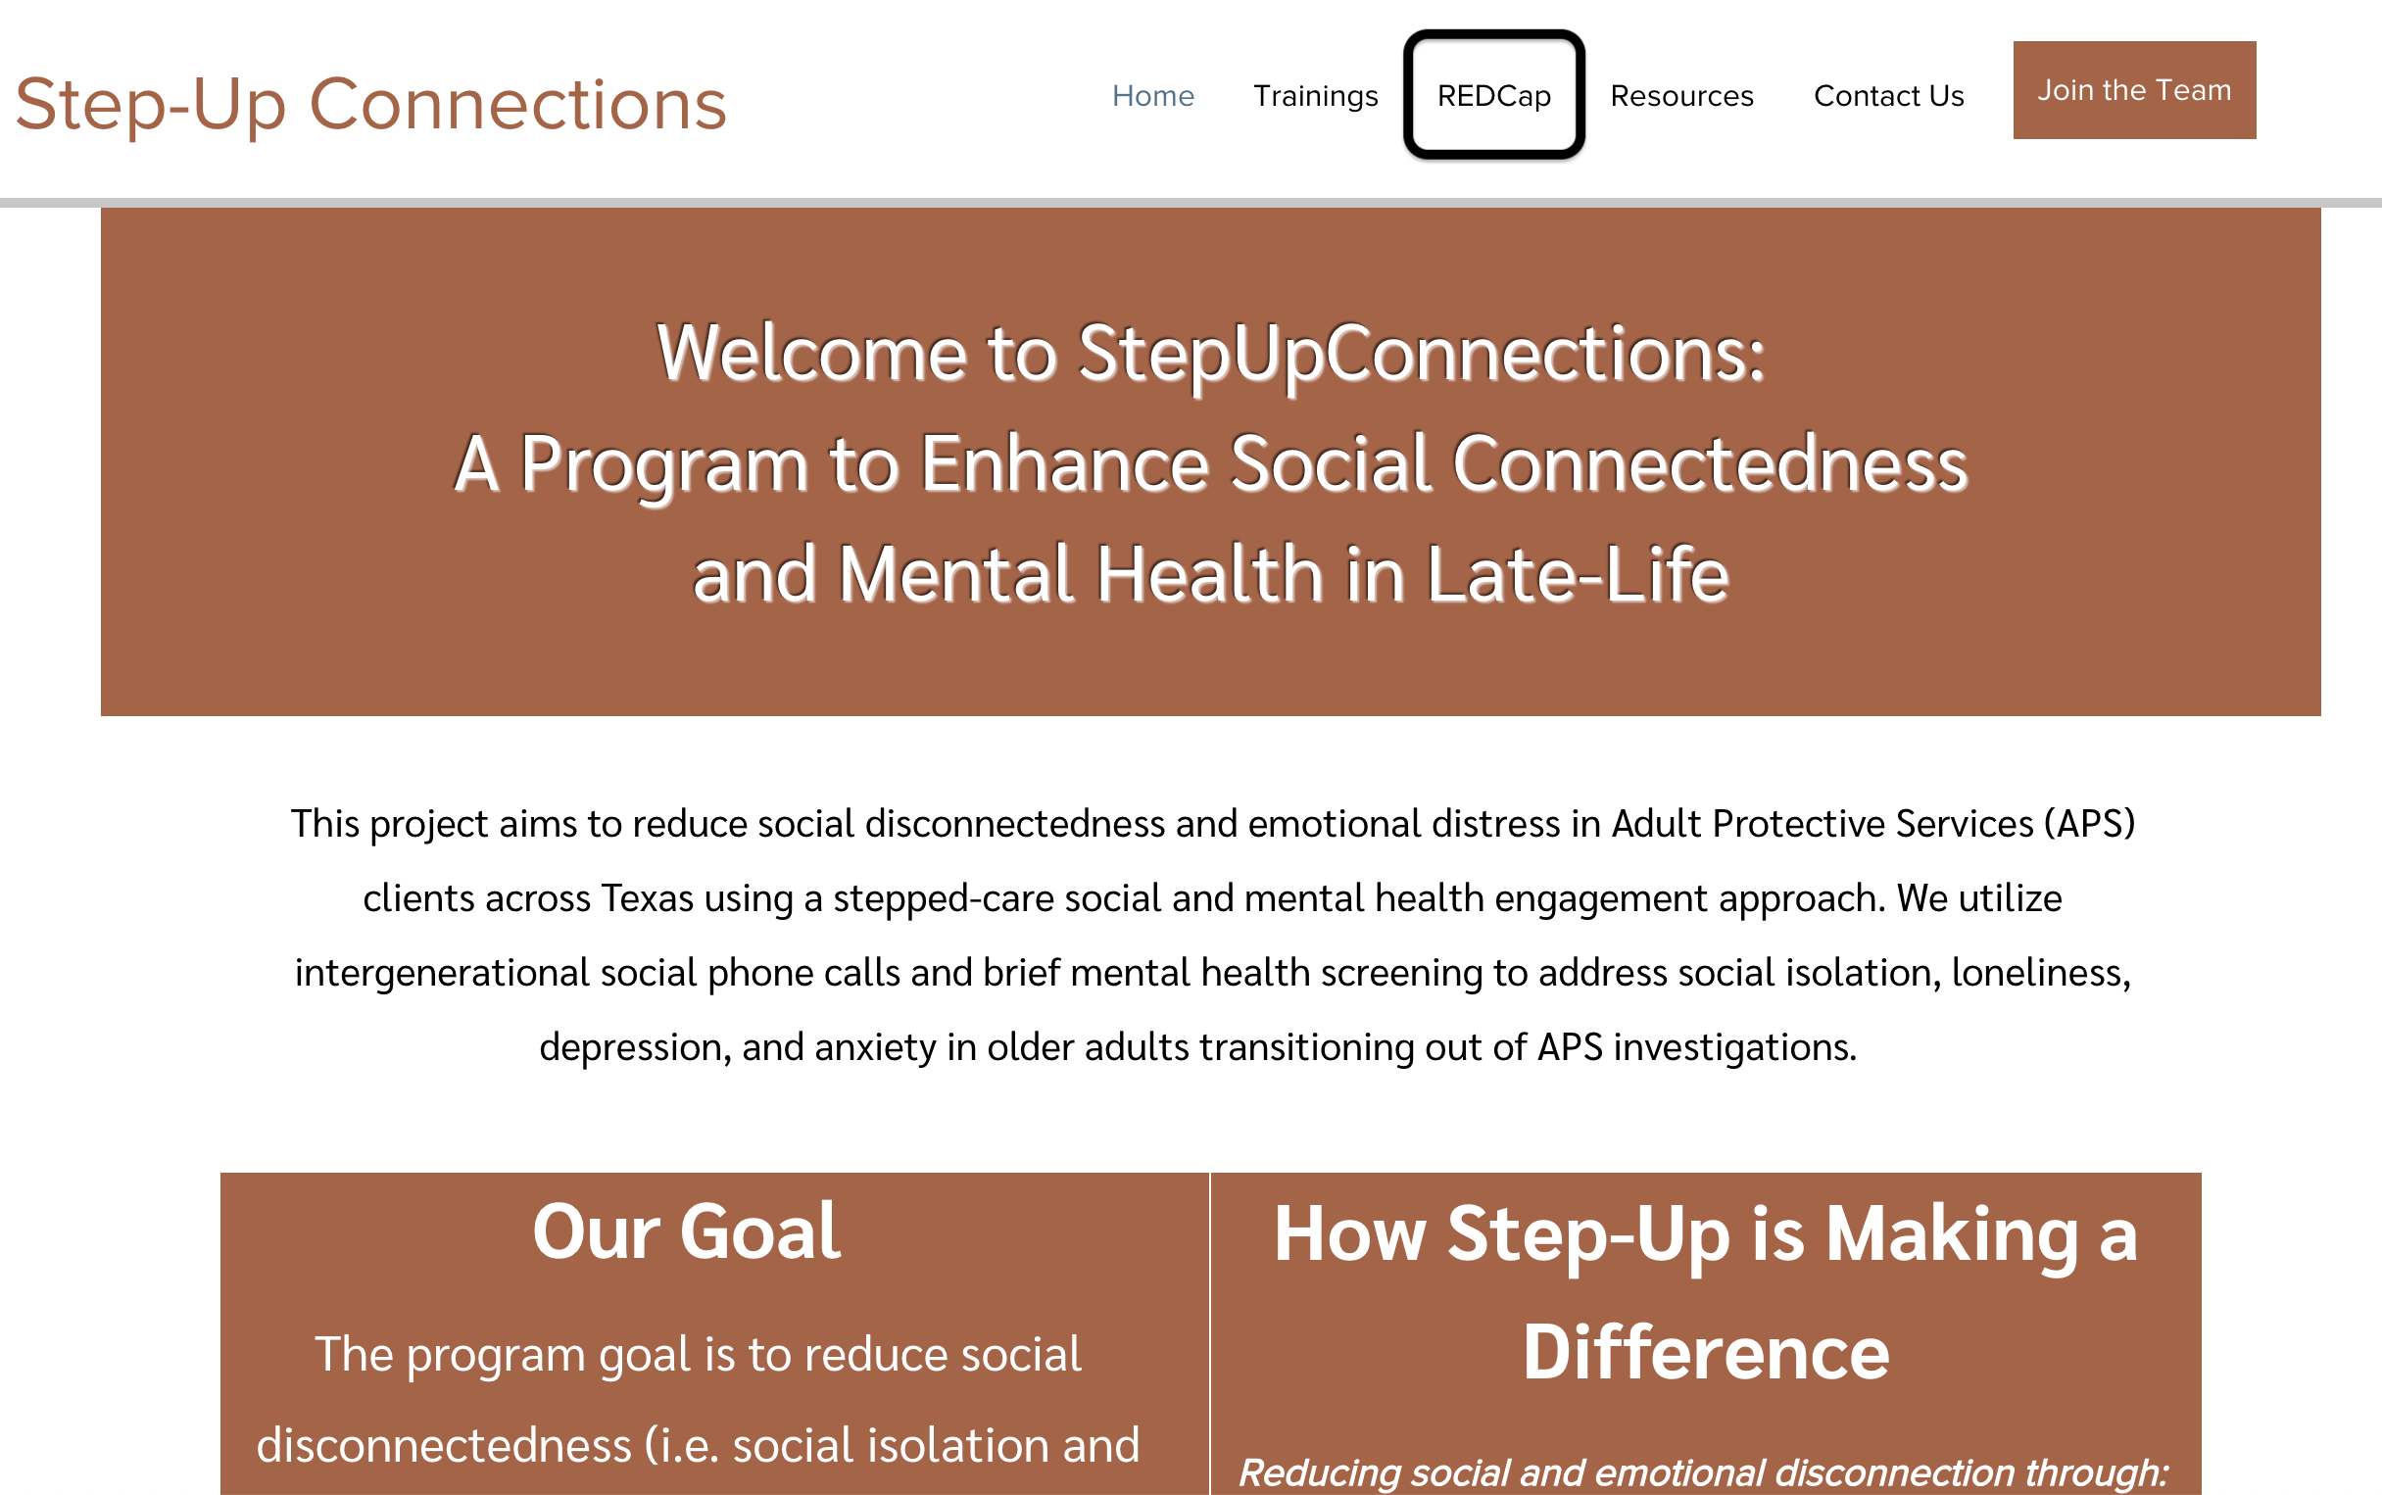
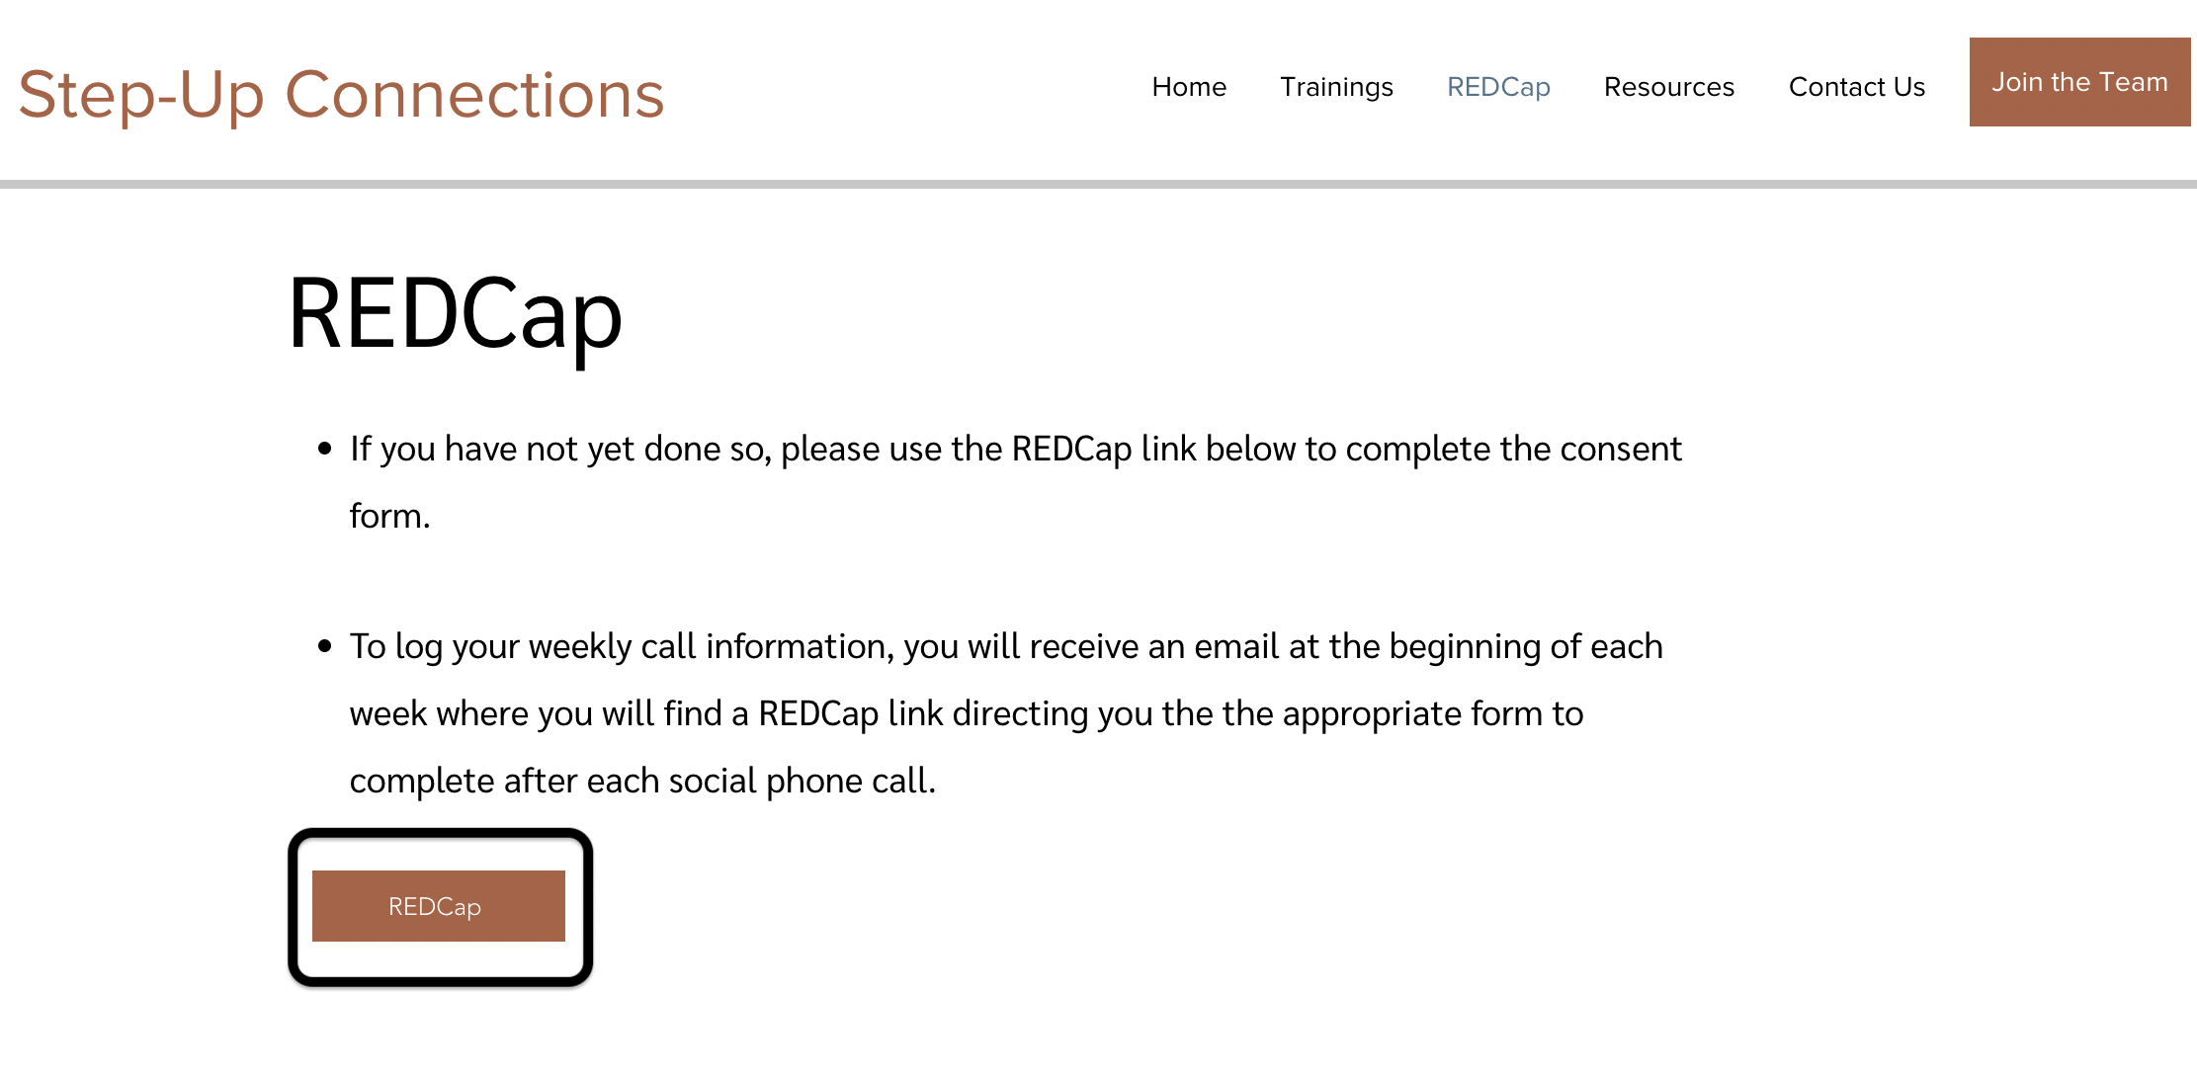
Accessing REDCap
At this point you should have already completed the consent form using the REDCap link found on the stepuptexas.org website

Slide 6
How will you access the call log using REDCap?
The call log you will fill out after each social phone will be submitted through REDCap.
Each week you will receive an email with a link.
It is important to fill out the call log after each call. Reminders will be sent out throughout the week as well.
This link will gain you access to the call log where you will complete the assessments and journaling questions.

Slide 7
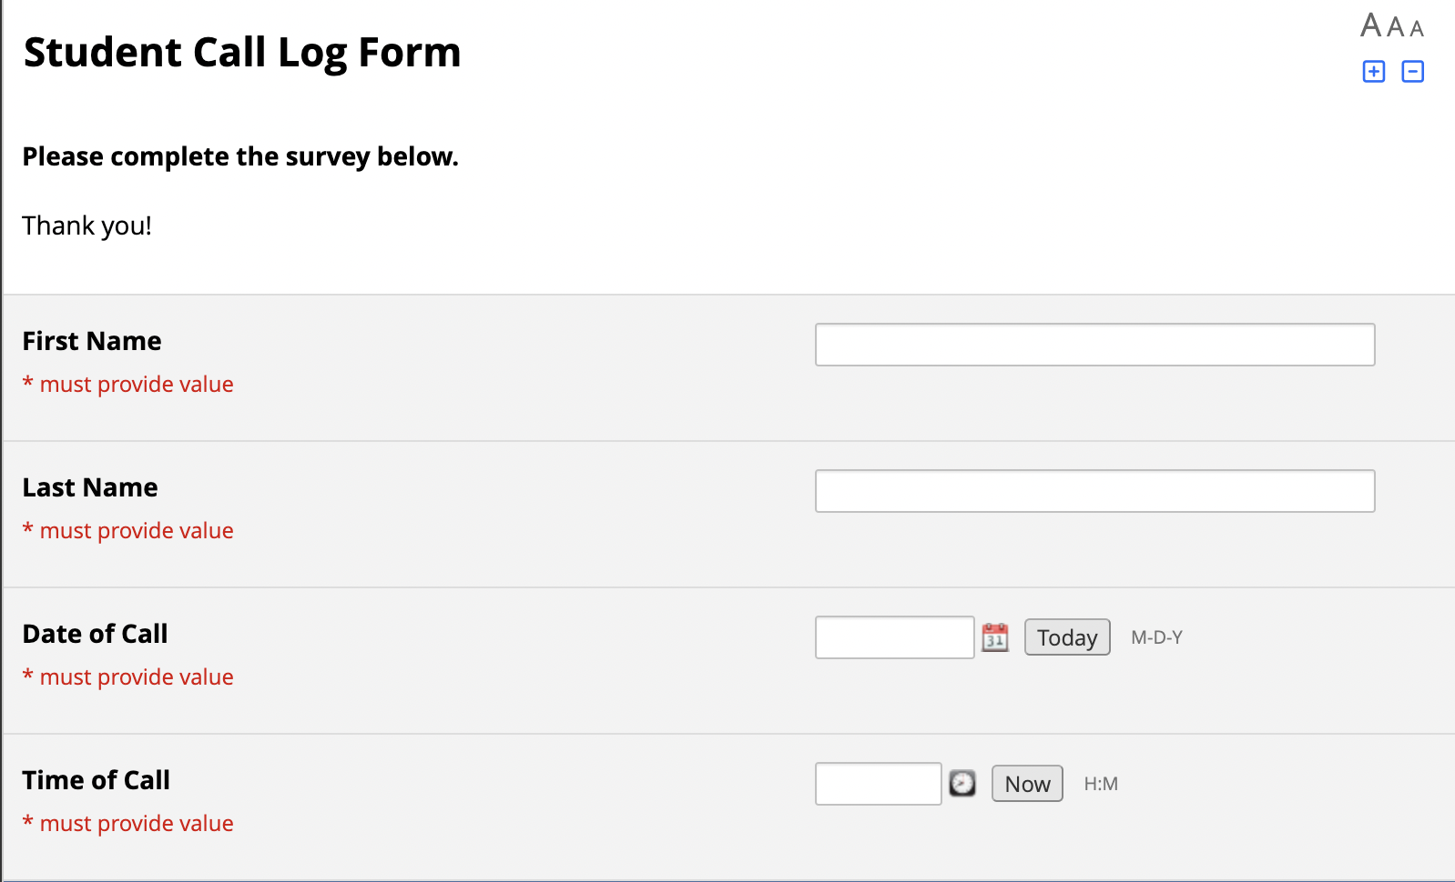
What will the call log look like?
When you click the link to the call log, you will see the whole form to complete.
Before you place your call, fill in your first and last name, the date of the call, and the time of the call.
Once you fill in this information, place your call.
Keep the form open and easily accessible so you can complete the assessments closer to the end of the call.

Slide 8
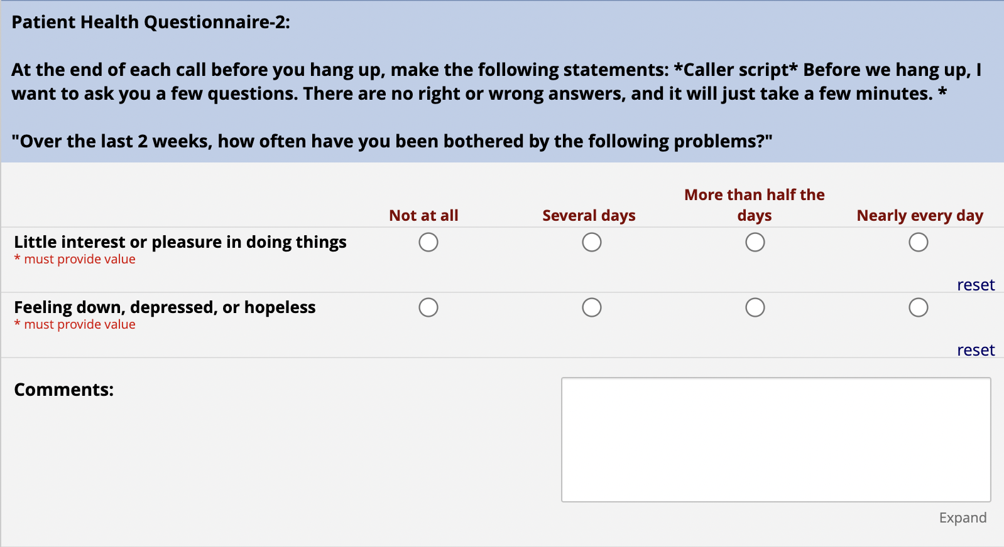
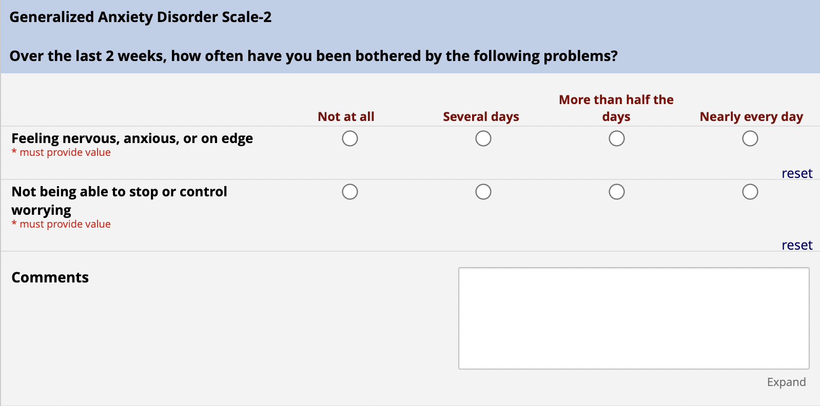
What will the call log look like?
Before you end the phone call, ask the older adult to answer a few questions.
PHQ-2
GAD-2
Make sure you ask each question, record their answers, and leave any comments if necessary.

Slide 9
What will the call log look like?
Throughout your phone call, listen for any indications of suicide or self-harm.
If self-harm or suicide is mentioned, you will answer YES to “Was self-harm or suicide mentioned?” and continue with the 7-item Columbia-Suicide Severity Rating Scale as prompted.
If self-harm or suicide is NOT mentioned throughout the phone call, answer no and continue with the call log.

Slide 10
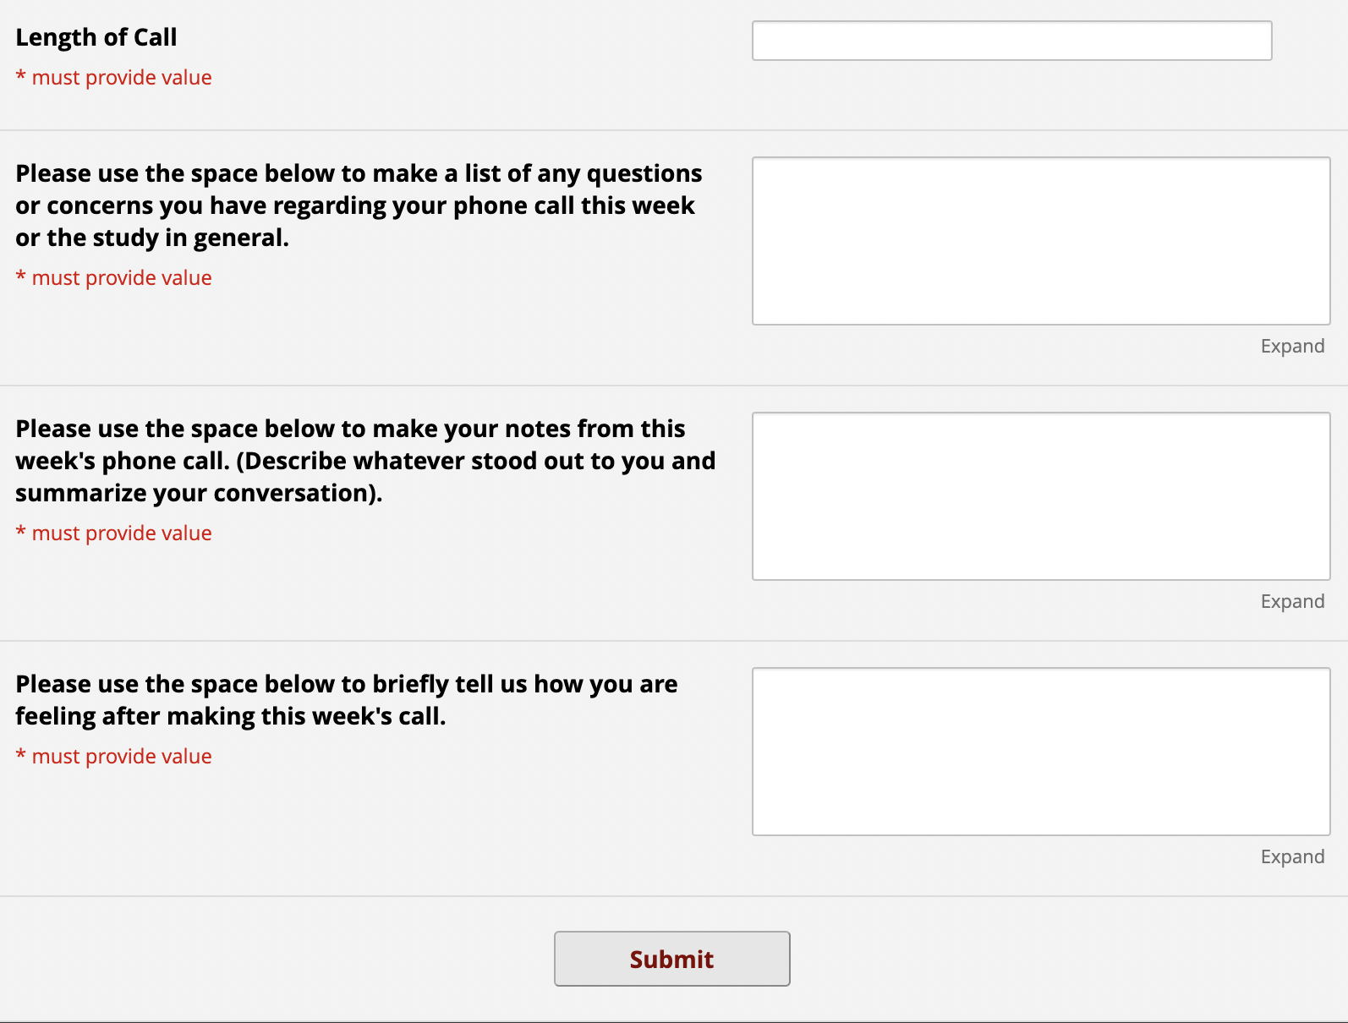
What will the call log look like?
After your phone call, complete the journaling question.
This is a great way to take note of whatever stood out to you and where you can summarize your conversation.
This is also where you can ask the Step-Up Connections Team questions and tell us how you are feeling about your conversations and the program.

Slide 11
Questions
If you have questions or problems with REDCap, please reach out to
Sophia Wasik (sophia.wasik@uth.tmc.edu) or
Dr. Jason Burnett (jason.burnett@uth.tmc.edu).

